Slide 1

Information Management and Technology
William Chen

Slide 2
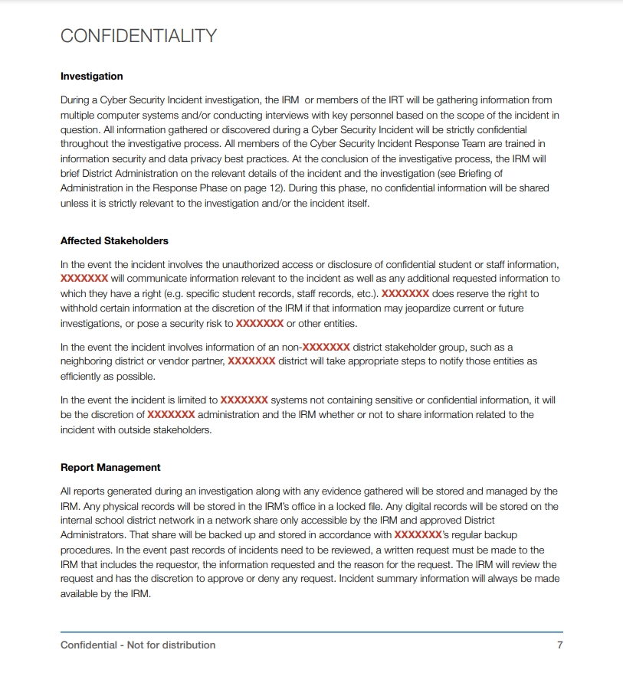
Security Analyst Responsibilities
Monitor, prevent, and stop attacks
Look for weaknesses
Prepare reports that document security breaches and damages caused by breaches
Incident Response Plan
Identify the breach
Assess the breach
Respond to the breach
Report and review

Slide 3
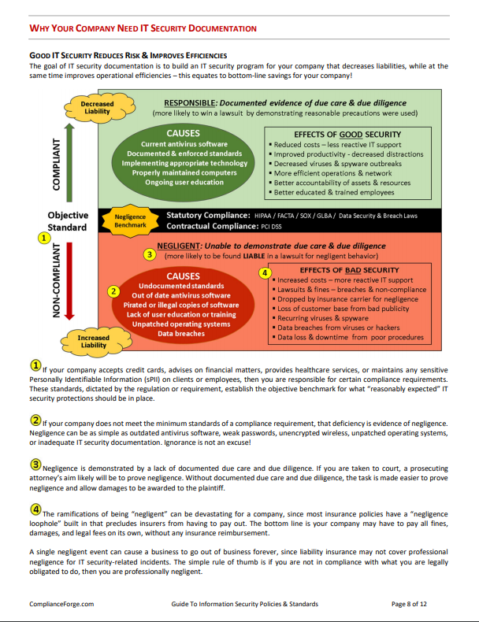
IT Security Policies and Standards
Required by most companies
Used to protect the data of employees and clients

Slide 4
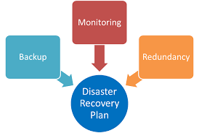
Disaster Recovery Plan (DRP)
Set of procedures used to recover and protect a business in the event of a disaster
Natural disasters, cyber-attacks, power outages
Prevention
Prevent the disaster from occuring in the first place
Detection
Detect the disaster
Correction
Resolve the issue and update the system

Slide 5

Typical person working
Needs at least a bachelor's degree in computer science or related field
Needs to have previous experience
Median Salary: $99,730 per year

Slide 6
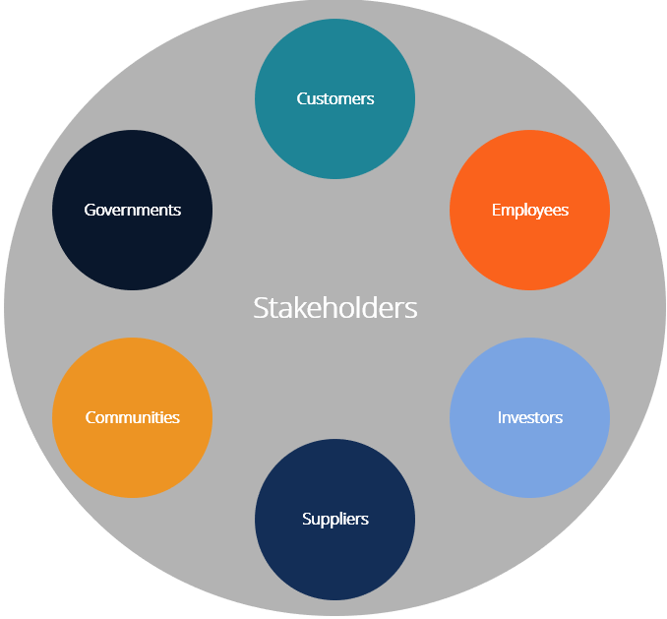
Stakeholders
Cybersecurity stakeholders are private and government
Other businesses such as Deloitte, KPMG, Apple, Dell
Private stakeholders are more successful
Lack of salary makes government jobs unappealing

Slide 7
References
www.investopedia.com/terms/i/information-management-technology-imt.asp.
https://www.bls.gov/ooh/computer-and-information-technology/information-security-analysts.htm#tab-2
https://www.esboces.org/cms/lib/NY01914091/Centricity/Domain/440/Incident%20Response%20Plan%20Template.6.5.19.pdf
http://examples.complianceforge.com/complianceforge-introduction-guide-to-information-security-policy-cybersecurity-program-documenation.pdf
https://learn.canvas.net/courses/37/pages/study-how-do-the-three-types-of-internal-control-activities-safeguard-assets
https://bluestonesearchchicago.com/are-disaster-recovery-plans-necessary-for-organizations/
https://www.politico.com/story/2013/02/in-cyberwar-wereour-own-worst-enemy-087998
https://sfmagazine.com/post-entry/november-2017-cybersecurity-stakeholders/

